Slide 1


Title
A Guide To Raising Capital Efficiently In The Shortest Amount Of Time Possible Regardless Of Industry, Region, Stage Or Deal Type In All Market Conditions

Slide 2
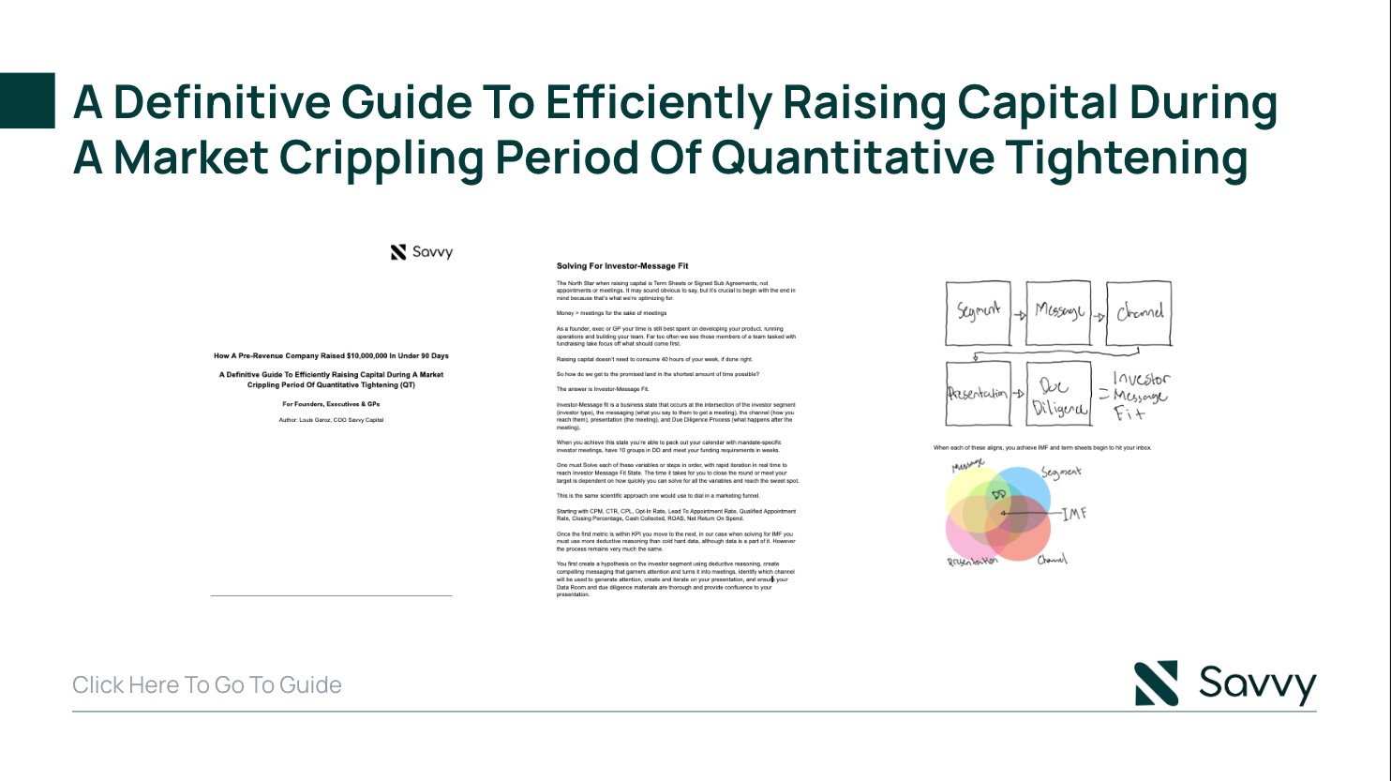
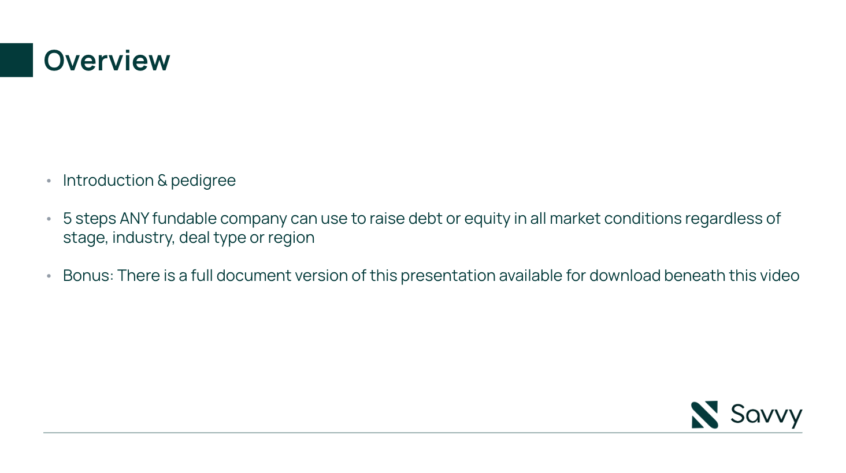

Overview

Slide 3
A Guide To Raising Capital Efficiently In The Shortest Amount Of Time Possible

Slide 4
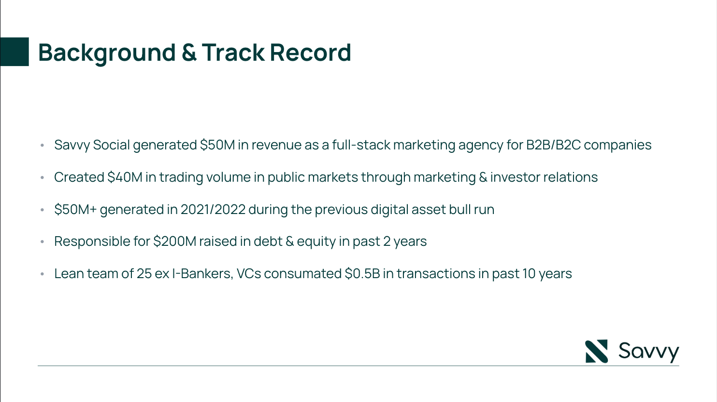
With a background in SaaS, Venture Capital, Digital Transformation, Defense and Pharma, Standard Demand Partners accelerates businesses in the capital markets with large scale marketing campaigns.
Lean team of 15 ex I-Bankers, VCs consummate $0.5B in transactions in past 10 years
Most recently helped SaaS startup Ray Analytics raise valuation to $2M in 2024

Slide 5
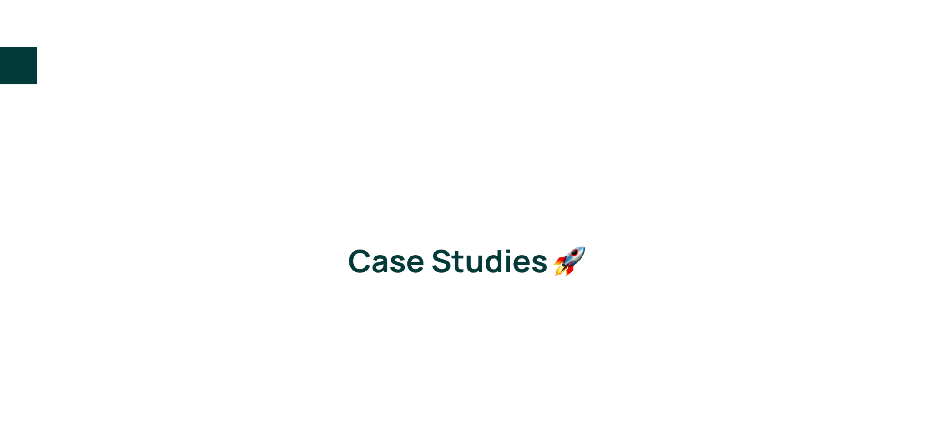

Slide 6
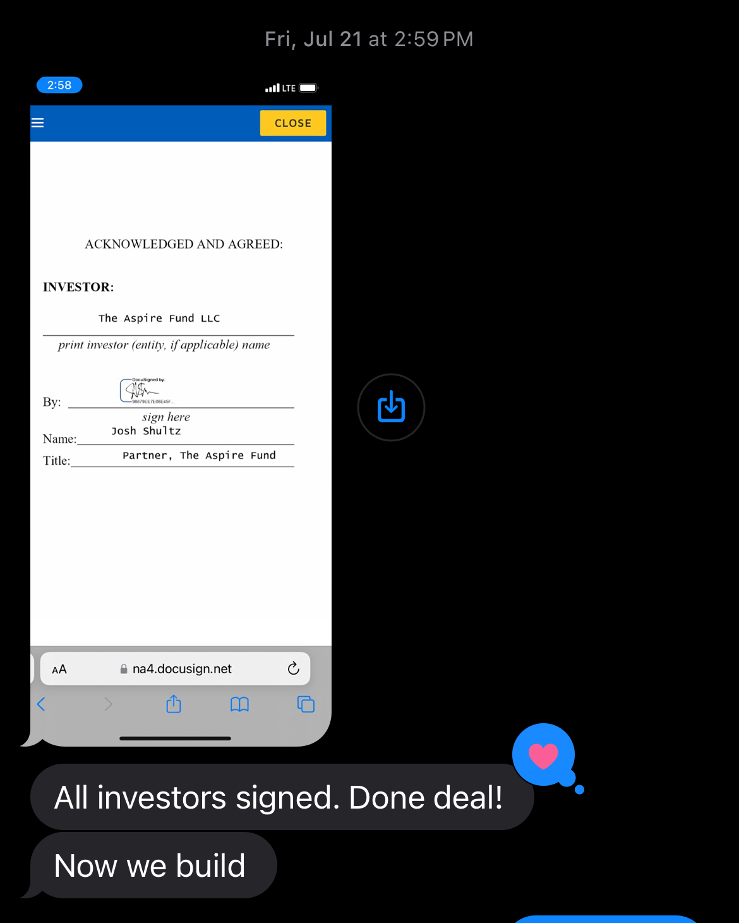
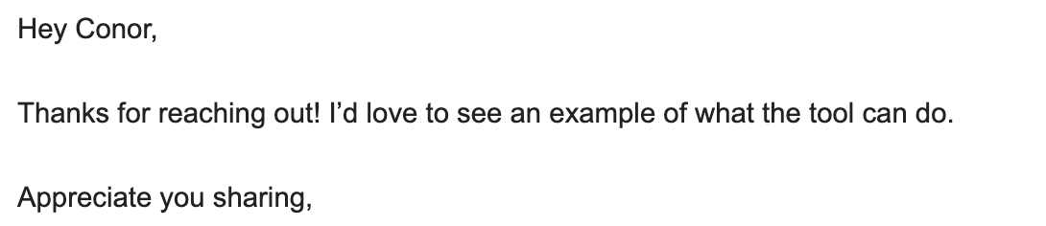

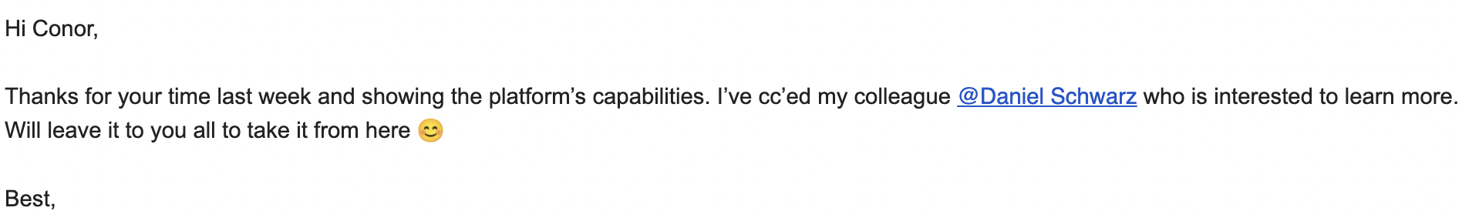
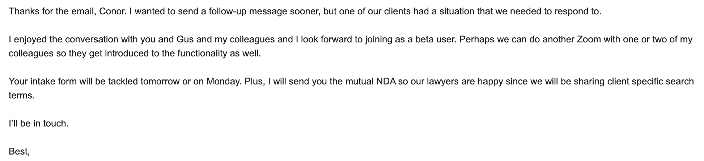
Helped Ray Analytics secure $2M from private raise and scale customer base during beta period

Slide 7
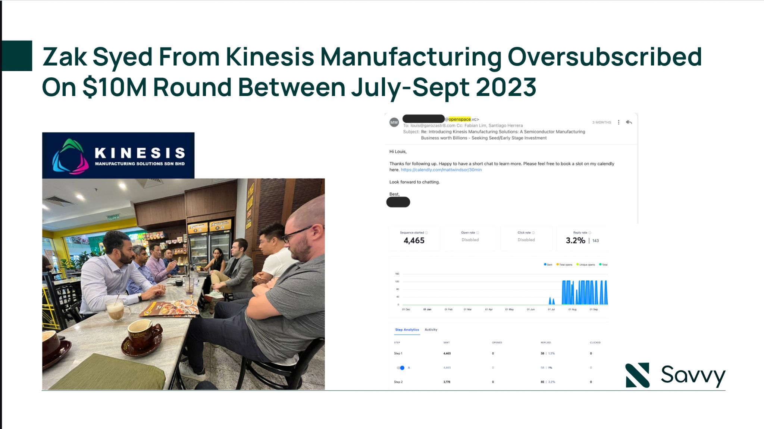

Slide 8
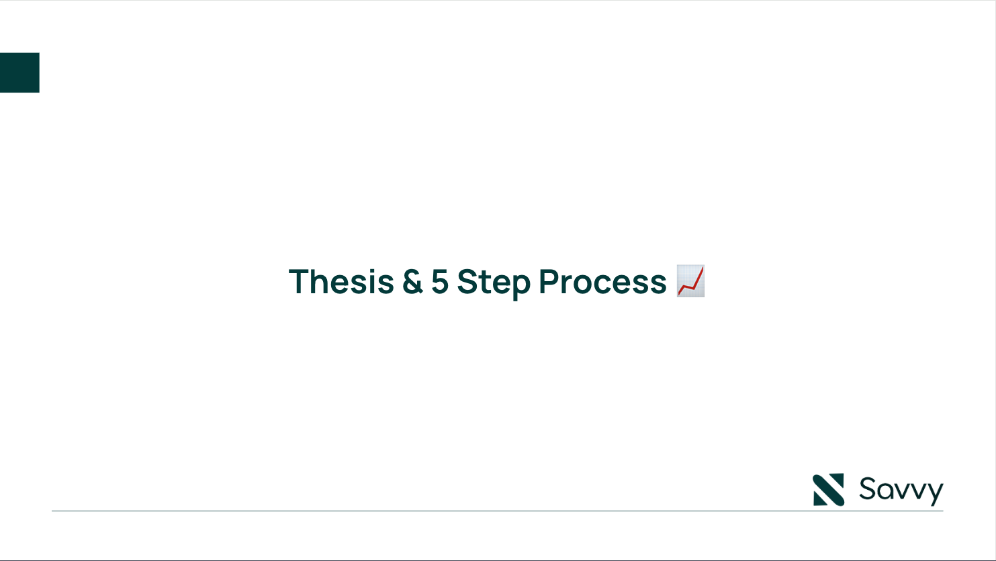

Slide 9
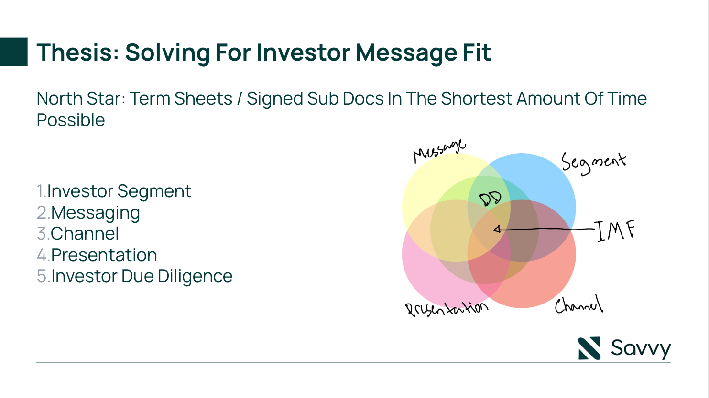

Slide 10
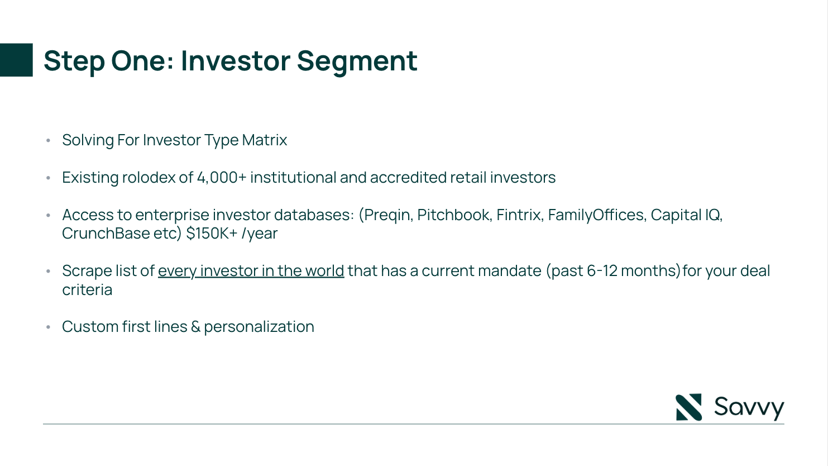

Slide 11
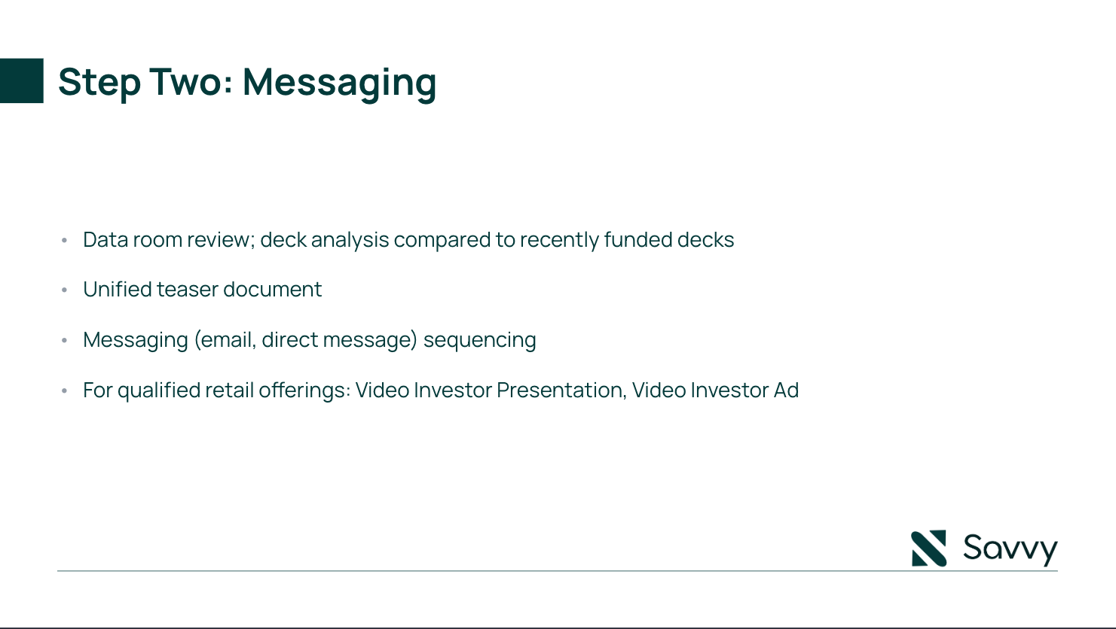

Slide 12
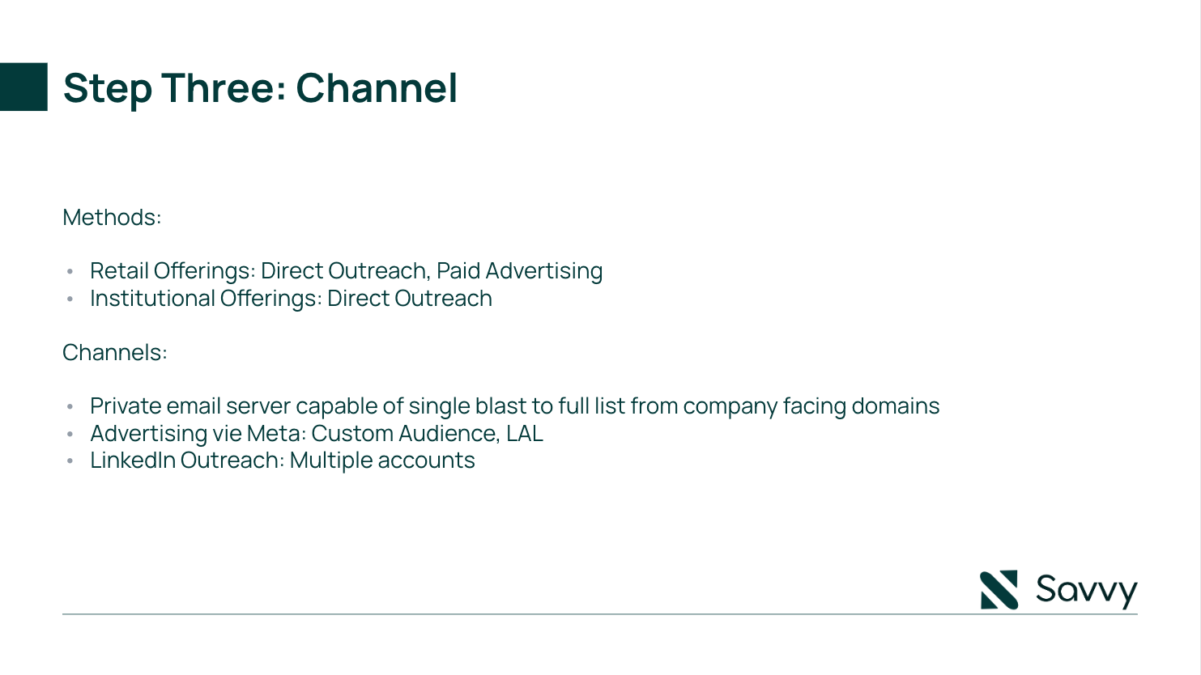

Slide 13
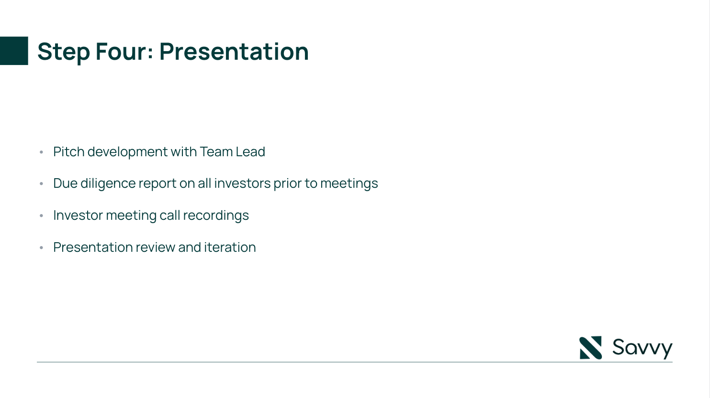

Slide 14
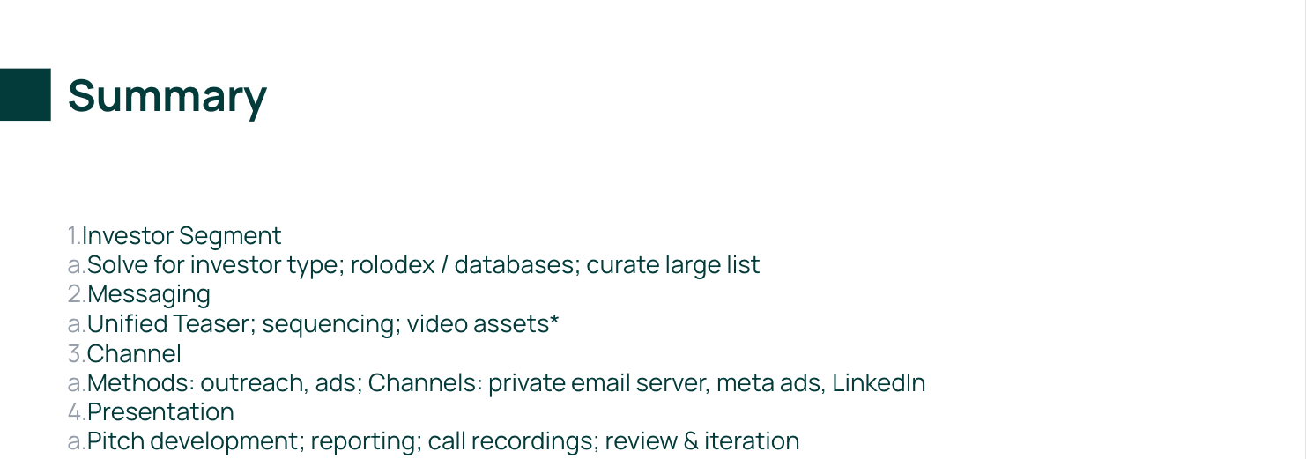

Slide 15
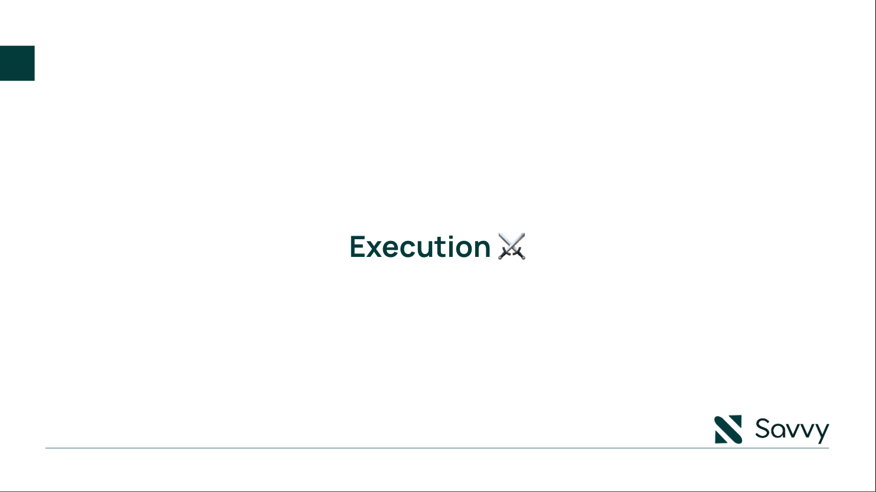

Slide 16
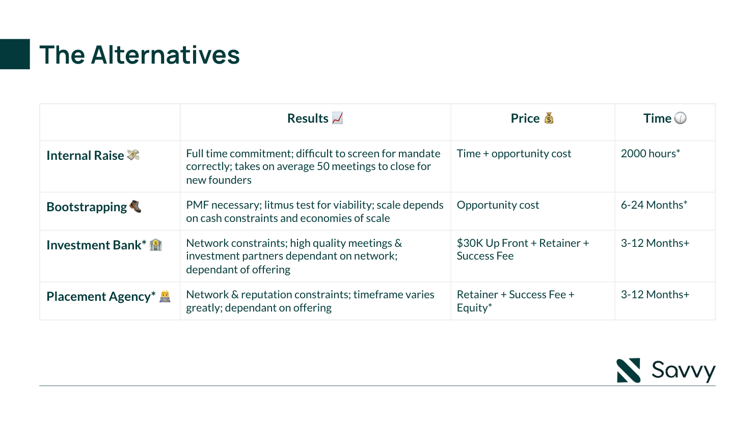

Slide 17
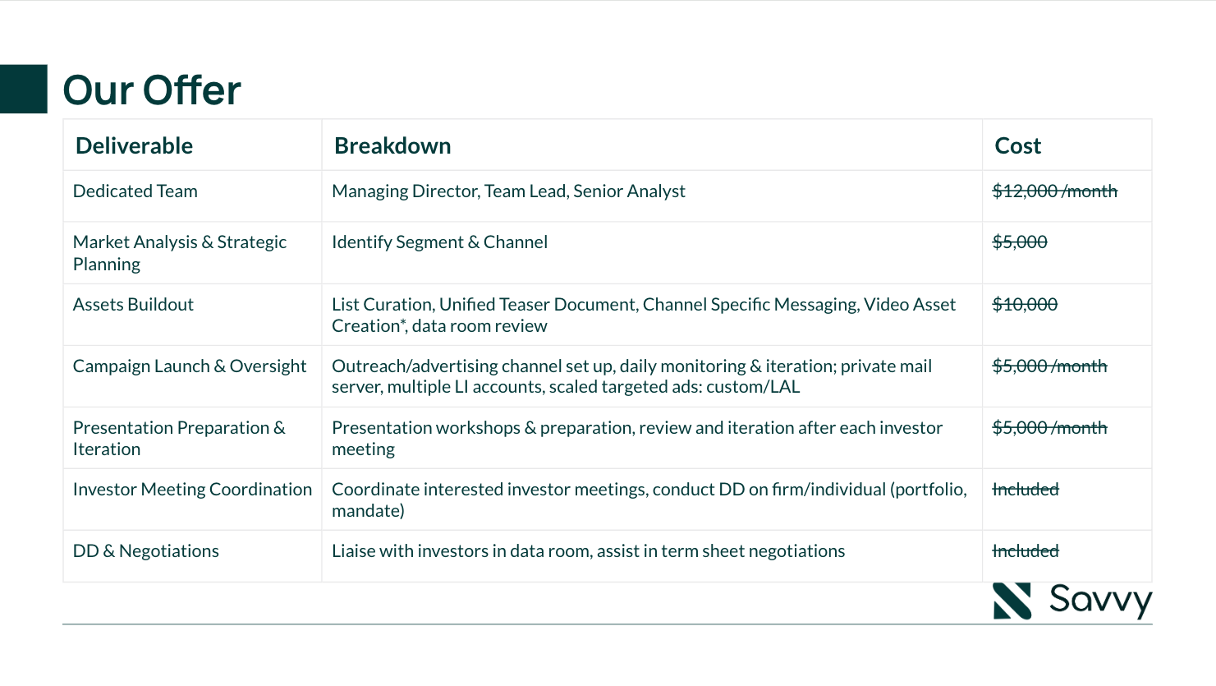

Slide 18
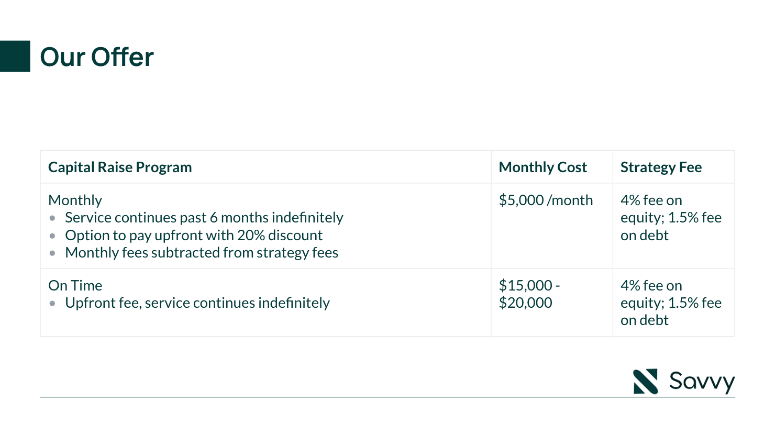
$5,000 -
$15,000

Slide 19
